Slide 1
Adversarial Examples Are Not Bugs They are Features
Zhang Huangzhao
Yuan Pei College

Slide 2
Overview
Adversarial examples
A new perspective
Some definitions
Finding robust/non-robust features
Disentangling robust features
Disentangling non-robust features
Transferability from non-robust features

Slide 3
Adversarial examples
Adversarial vulnerability – Almost all machine learning models are vulnerable to adversarial examples.
Adversarial transferability – Adversarial perturbations for one model often transfer to other independently trained models.

Slide 4
Adversarial examples (2)
MNIST
Original 0’s
Generation process
Adversarial examples (1-9)

Slide 5
Adversarial examples (3)
IMDB binary sentimental classification
i
really
love
this
movie
Sentiment
Classifier
<pos> 93%
i
truly
love
this
movie
<pos> 79%
i
truly
love
the
movie
<pos> 63%
i
truly
love
the
film
<neg> 59%

Slide 6
Adversarial examples (4)
Non-robust features
Highly predictive features derived from patterns in data distribution.
Incomprehensible to human beings.
Aberrations?
High dimensional nature of the input space.
Statistical fluctuations in the training data.
Goal – adversarial robustness

Slide 7
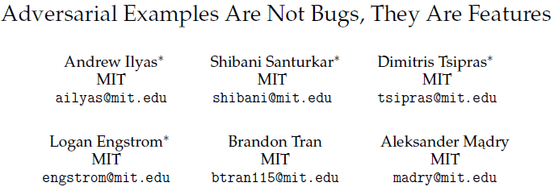
https://arxiv.org/abs/1905.02175

Slide 8

A new perspective
Non-robust features – predictive but not human-comprehensible.
Robust features – predictive and human-comprehensible.

Slide 9
A new perspective (2)
Adversarial vulnerability – A fundamental consequence of the dominant supervised learning paradigm.
Adversarial vulnerability is purely human-centric phenomenon.
During standard supervised learning, non-robust features can be as important as robust ones.
Adversarial vulnerability is a direct result of our models’ sensitivity to well-generalizing features in the data.
Adversarial transferability – Any two models are likely to learn similar non-robust features. Manipulating such features will apply to both models.

Slide 10
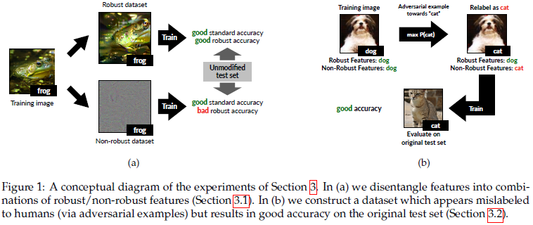
A new perspective (3)
Disentangle robust from non-robust features is possible
Given any training dataset,
A robust version for robust classification is possible (remove non-robust).
A non-robust version for standard classification is possible (adversarial training).

Slide 11

Some definitions
Binary classification
Input-label pair – $\left(x,y\right)∈X×\left\{±1\right\}, where X×\left\{±1\right\}∼D$
Classifier – $C:X→\left\{±1\right\}$
Feature – $f:X→R, where E_{\left(x,y\right)∼D}\left[f\left(x\right)\right]=0 and E_{\left(x,y\right)∼D}\left[f{\left(x\right)}^{2}\right]=1$

Slide 12
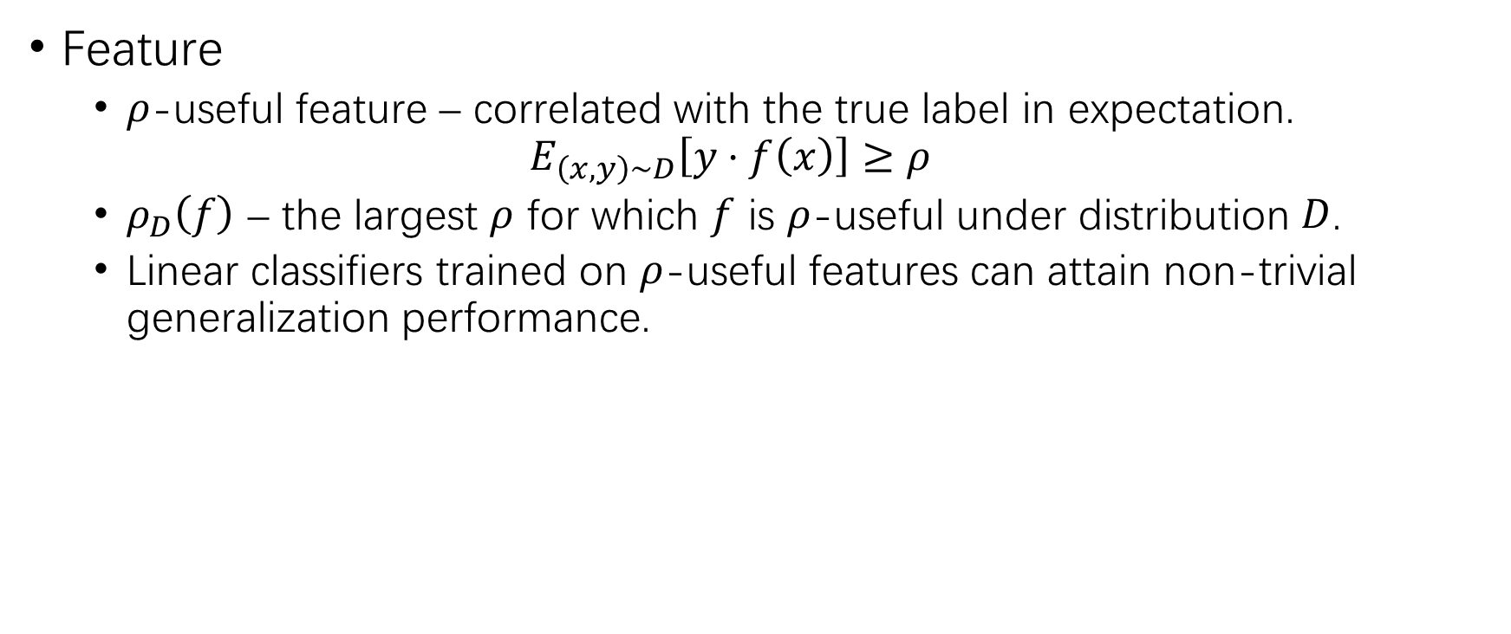
Some definitions (2)
Feature
$ρ$-useful feature – correlated with the true label in expectation.
$$E_{\left(x,y\right)∼D}\left[y⋅f\left(x\right)\right]≥ρ$$
$ρ_{D}\left(f\right)$ – the largest $ρ$ for which $f$ is $ρ$-useful under distribution $D$.
Linear classifiers trained on $ρ$-useful features can attain non-trivial generalization performance.

Slide 13
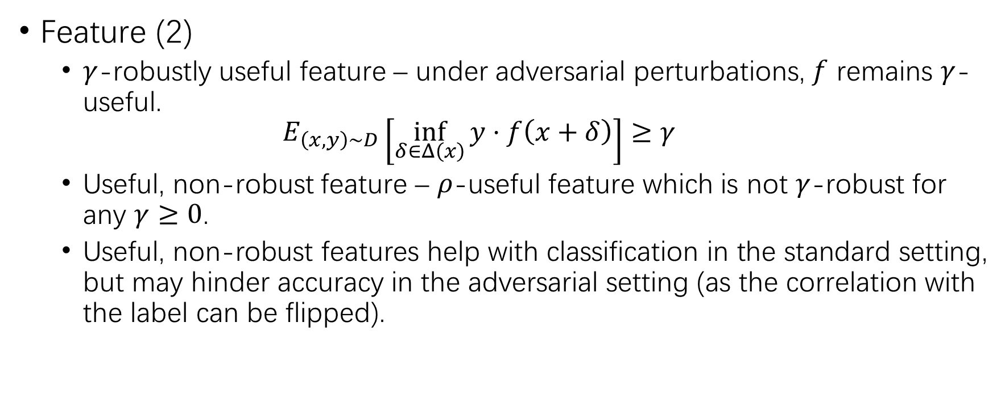
Some definitions (3)
Feature (2)
$γ$-robustly useful feature – under adversarial perturbations, $f$ remains $γ$-useful.
$$E_{\left(x,y\right)∼D}\left[\inf_{δ∈Δ\left(x\right)}{y⋅f\left(x+δ\right)}\right]≥γ$$
Useful, non-robust feature – $ρ$-useful feature which is not $γ$-robust for any $γ≥0$.
Useful, non-robust features help with classification in the standard setting, but may hinder accuracy in the adversarial setting (as the correlation with the label can be flipped).

Slide 14

Some definitions (4)
Classification
Classifier – $C=\left(F,w,b\right)$
$$C\left(x\right)=\operatorname{sgn}\left(b+\sum_{f∈F}{w_{f}⋅f\left(x\right)}\right)$$
Feature set learned by $C$ – $F_{C}$

Slide 15
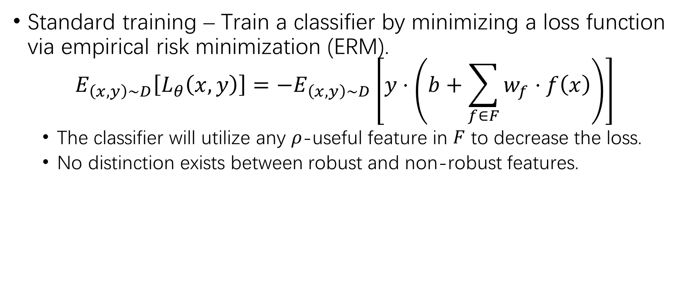
Some definitions (5)
Standard training – Train a classifier by minimizing a loss function via empirical risk minimization (ERM).
$$E_{\left(x,y\right)∼D}\left[L_{θ}\left(x,y\right)\right]=−E_{\left(x,y\right)∼D}\left[y⋅\left(b+\sum_{f∈F}{w_{f}⋅f\left(x\right)}\right)\right]$$
The classifier will utilize any $ρ$-useful feature in $F$ to decrease the loss.
No distinction exists between robust and non-robust features.

Slide 16

ERM
Interruption!
ERM?
True risk – Given hypothesis set $H$, joint distribution $P\left(x,y\right)$ and loss function $L\left(\hat{y},y\right)$, minimize $R\left(h\right)$.
$$R\left(h\right)=E\left[L\left(h\left(x\right), y\right)\right]=∫L\left(h\left(x\right),y\right) dP(x,y)$$
Empirical risk – $P\left(x,y\right)$ is not available. Given $H$, $L\left(\hat{y},y\right)$ and training set $\left(X,Y\right)=\left\{\left(x_{1},y_{1}\right),⋯ \right\}$, minimize $R_{emp}\left(h\right)$.
$$R_{emp}\left(h\right)=\frac{1}{n}\sum_{i=1}^{n}{L\left(h\left(x_{i}\right),y_{i}\right)}$$

Slide 17
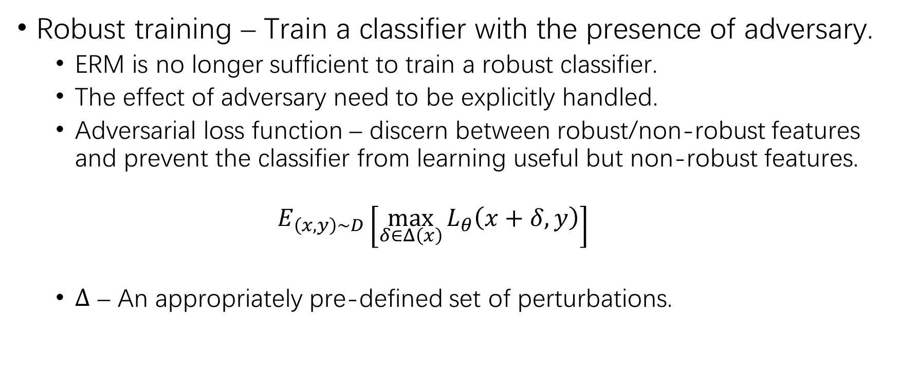
Some definitions (6)
Robust training – Train a classifier with the presence of adversary.
ERM is no longer sufficient to train a robust classifier.
The effect of adversary need to be explicitly handled.
Adversarial loss function – discern between robust/non-robust features and prevent the classifier from learning useful but non-robust features.
$$E_{\left(x,y\right)∼D}\left[\max_{δ∈Δ\left(x\right)}{L_{θ}\left(x+δ,y\right)}\right]$$
$Δ$ – An appropriately pre-defined set of perturbations.

Slide 18
Finding robust/non-robust features
There exist both robust and non-robust features that constitute useful signals for standard classification.
Robustified dataset – dataset consist of samples which primarily contain robust features, by removing certain features.
Non-robust dataset – input-label association is purely based on non-robust features.

Slide 19
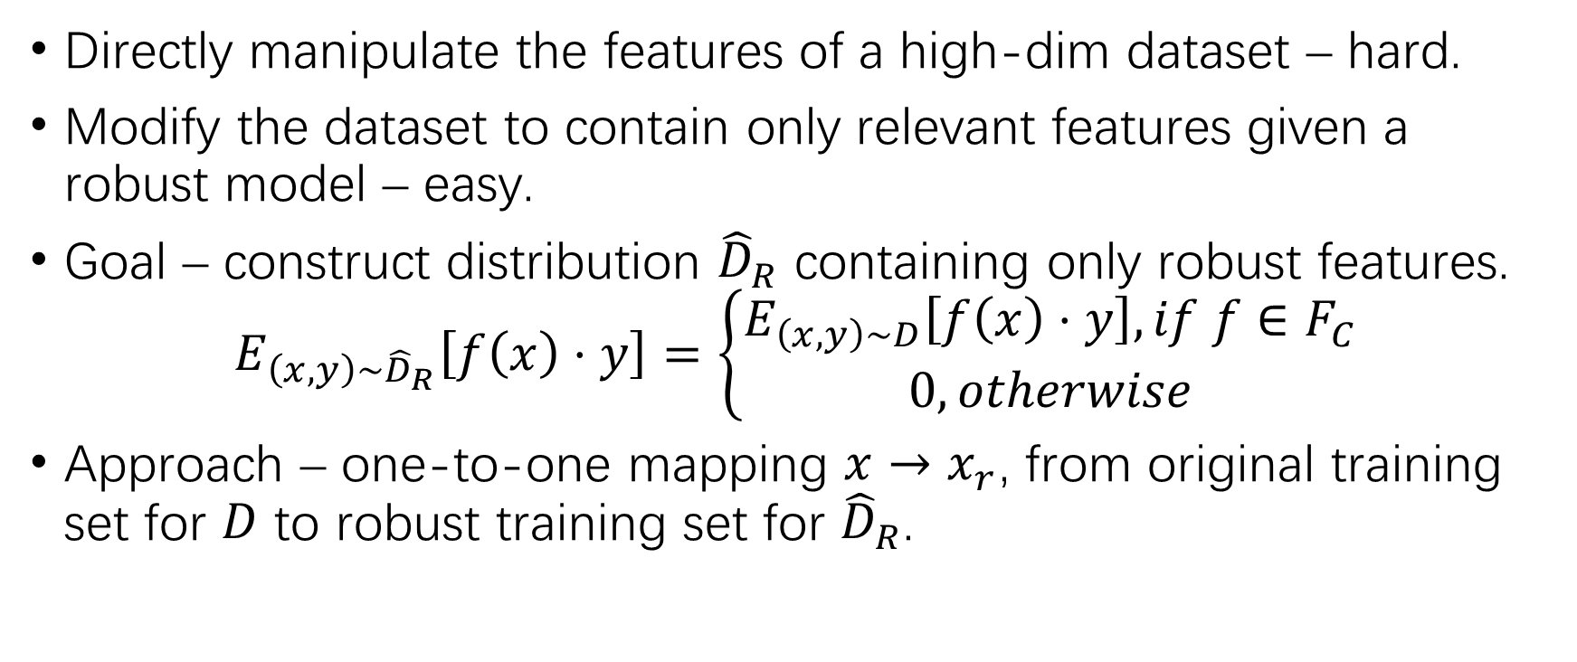
Disentangling robust features
Directly manipulate the features of a high-dim dataset – hard.
Modify the dataset to contain only relevant features given a robust model – easy.
Goal – construct distribution ${\hat{D}}_{R}$ containing only robust features.
$$E_{\left(x,y\right)∼{\hat{D}}_{R}}\left[f\left(x\right)⋅y\right]=\left\{\begin{aligned}E_{\left(x,y\right)∼D}\left[f\left(x\right)⋅y\right], if f∈F_{C} \\ 0, otherwise\end{aligned}\right.$$
Approach – one-to-one mapping $x→x_{r}$, from original training set for $D$ to robust training set for ${\hat{D}}_{R}$.

Slide 20
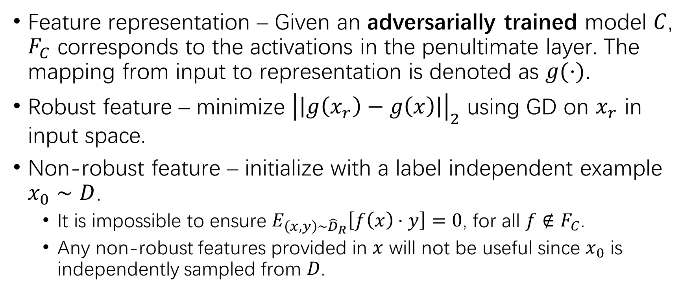
Disentangling robust features (2)
Feature representation – Given an adversarially trained model $C$, $F_{C}$ corresponds to the activations in the penultimate layer. The mapping from input to representation is denoted as $g(⋅)$.
Robust feature – minimize ${\left|\left|g\left(x_{r}\right)−g\left(x\right)\right|\right|}_{2}$ using GD on $x_{r}$ in input space.
Non-robust feature – initialize with a label independent example $x_{0}∼D$.
It is impossible to ensure $E_{\left(x,y\right)∼{\hat{D}}_{R}}\left[f\left(x\right)⋅y\right]=0$, for all $f∉F_{C}$.
Any non-robust features provided in $x$ will not be useful since $x_{0}$ is independently sampled from $D$.

Slide 21
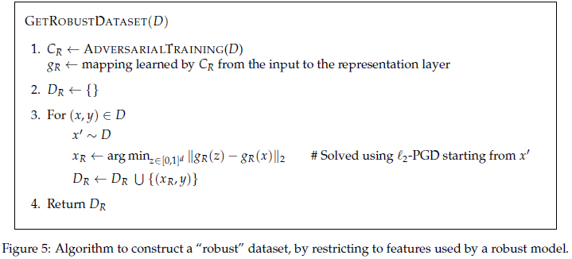
Disentangling robust features (3)

Slide 22
Disentangling non-robust features
Standard training on robustified datasets results in classifiers which are robust.
When training on the standard dataset, non-robust features take on large role in the resulting learned classifier.
Non-robust features alone suffice for standard generalization – a model trained solely on non-robust features can perform well on the standard test set.

Slide 23
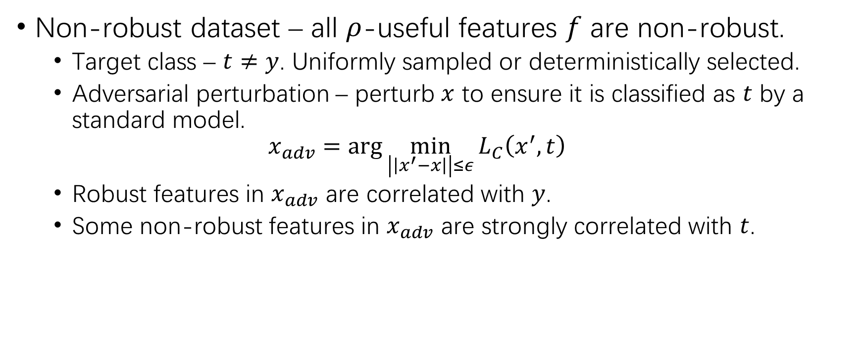
Disentangling non-robust features (2)
Non-robust dataset – all $ρ$-useful features $f$ are non-robust.
Target class – $t≠y$. Uniformly sampled or deterministically selected.
Adversarial perturbation – perturb $x$ to ensure it is classified as $t$ by a standard model.
$$x_{adv}=\arg{\min_{\left|\left|x^{′}−x\right|\right|≤ε}{L_{C}\left(x^{′},t\right)}}$$
Robust features in $x_{adv}$ are correlated with $y$.
Some non-robust features in $x_{adv}$ are strongly correlated with $t$.

Slide 24
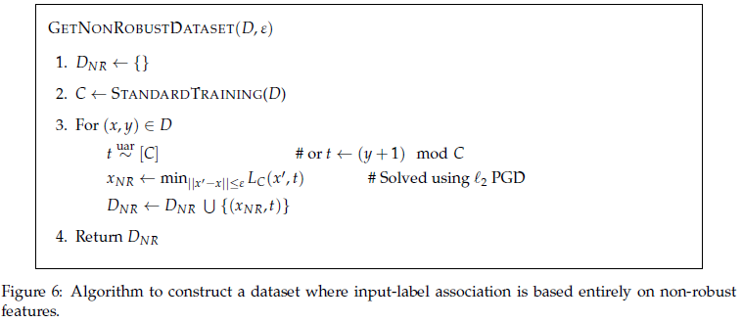
Disentangling non-robust features (3)

Slide 25
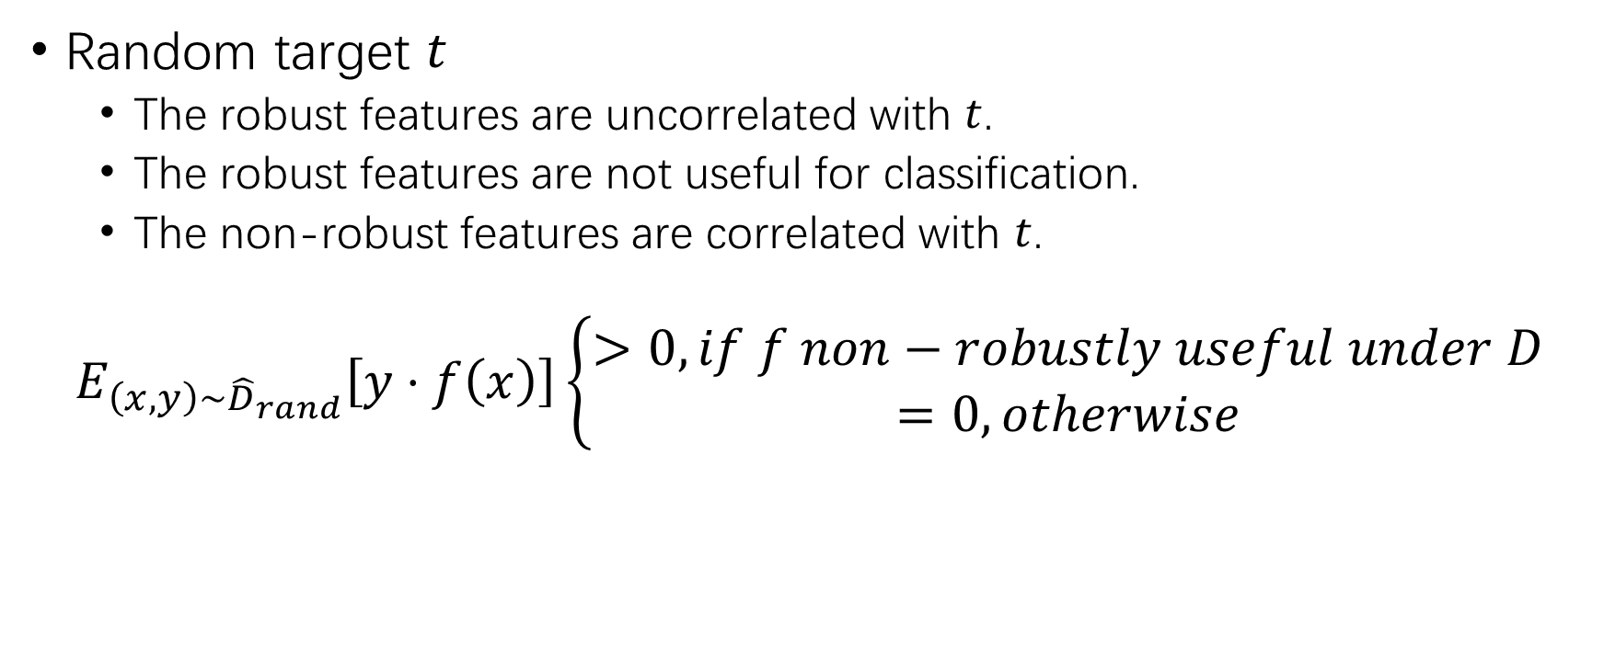
Disentangling non-robust features (4)
Random target $t$
The robust features are uncorrelated with $t$.
The robust features are not useful for classification.
The non-robust features are correlated with $t$.
$$E_{\left(x,y\right)∼{\hat{D}}_{rand}}\left[y⋅f\left(x\right)\right]\left\{\begin{aligned}>0, if f non−robustly useful under D \\ =0, otherwise\end{aligned}\right.$$

Slide 26
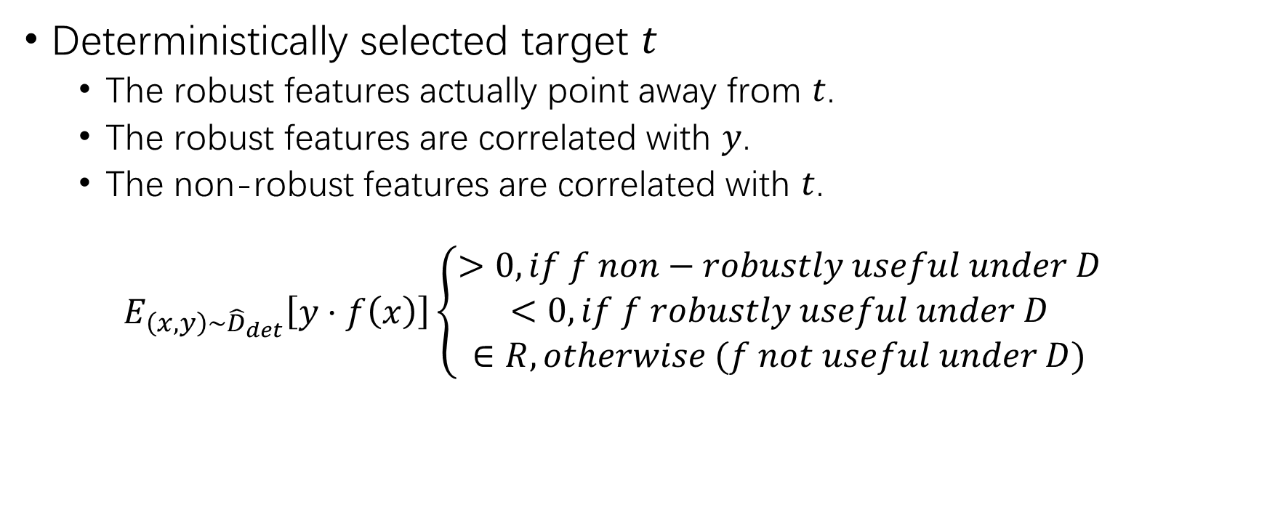
Disentangling non-robust features (5)
Deterministically selected target $t$
The robust features actually point away from $t$.
The robust features are correlated with $y$.
The non-robust features are correlated with $t$.
$$E_{\left(x,y\right)∼{\hat{D}}_{det}}\left[y⋅f\left(x\right)\right]\left\{\begin{aligned}>0, if f non−robustly useful under D \\ <0, if f robustly useful under D \\ ∈R, otherwise (f not useful under D)\end{aligned}\right.$$

Slide 27
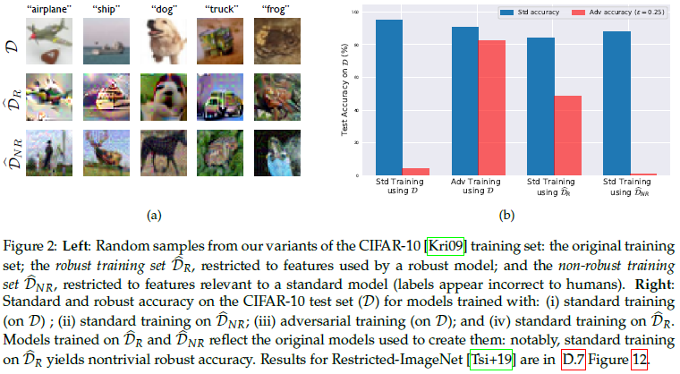

Results on ${\hat{D}}_{R}$ and ${\hat{D}}_{NR}$

Slide 28
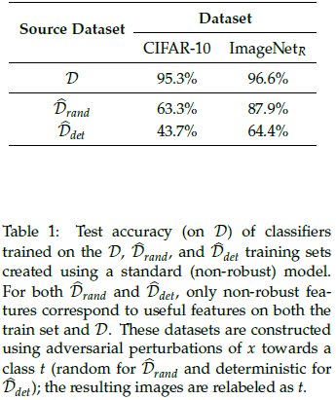
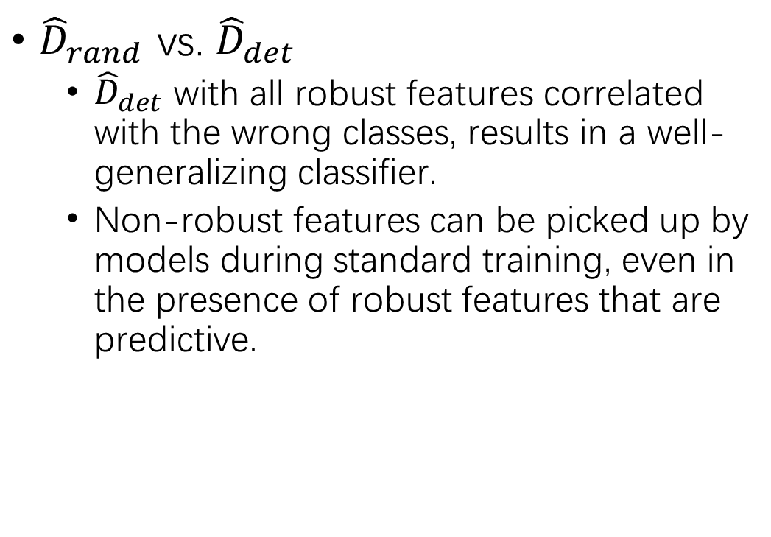

Results on ${\hat{D}}_{R}$ and ${\hat{D}}_{NR}$ (2)
${\hat{D}}_{rand}$ vs. ${\hat{D}}_{det}$
${\hat{D}}_{det}$ with all robust features correlated with the wrong classes, results in a well-generalizing classifier.
Non-robust features can be picked up by models during standard training, even in the presence of robust features that are predictive.

Slide 29
Transferability from non-robust features
Non-robust features are inherent to the data distribution
Different classifiers are trained on independent samples from the same distribution.
The classifiers are likely to utilize similar non-robust features.
Consequently, adversarial examples constructed by exploiting the non-robust features learned by one classifier will transfer to any other classifier utilizing these features in a similar manner.

Slide 30
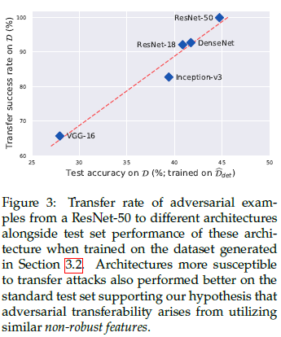
Transferability from non-robust features (2)
Architectures which learn better from dataset with deterministically labeled adversarial examples are more likely to learn similar non-robust features to the original classifier.

Slide 31
THANK YOU!

